Slide 1
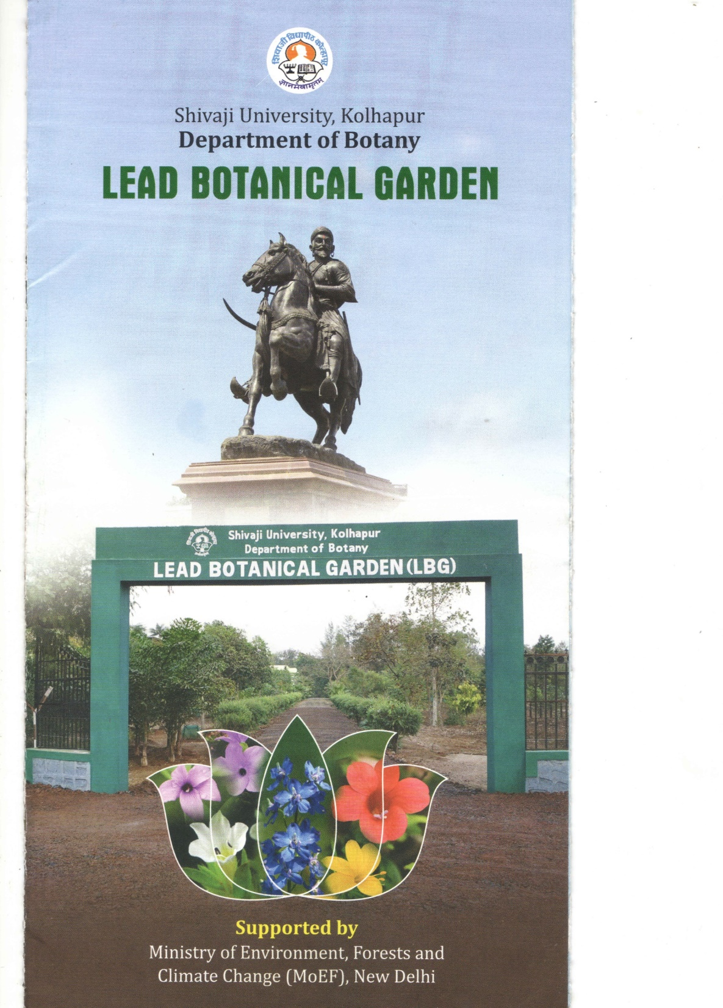

Slide 2
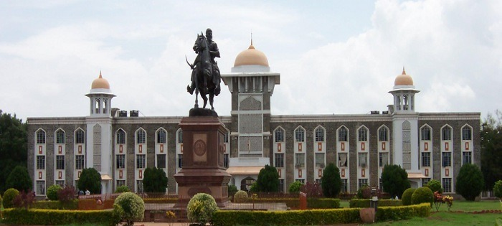
Home | About | Contact us | List of Plants | Sections | Key attraction | Events organized | About SUK Herbarium | New species described
Outline of website of Lead Botanical Garden

Slide 3
Home | About | Contact us | List of Pants | Sections | Key attraction | Events organized | About SUK Herbarium | New species described
History of Department
History of LBG
Map of LBG
Introduction to LBG
Objectives of LBG
Infrastructure of LBG
Achivements of LBG
Visitors
Information about garden
Head Department of Botany
Email & Contact
Dr. Manoj M. Lekhak
Email & Departmetal address
Prof. Dr. S. R. Yadav
Email & Departmental address

Slide 4
Home | About | Contact us | List of Pants | Sections | Key attraction | Events organized | About SUK Herbarium | New species described
Fernery
Pinetum
Rhizomatous, Cormatous, Tuberous and Bulbous plants
Aquatic plants
Medicinal Plants
Palmatum
Orchidarium
Arboretum of medicinal plants
Arboretum of Rare, Endangered and Threatened plants
Groves
Insectivorous plant
Climber
Endangered and endemic plants specie nursery
Mangrove nursery
Nilambari auditorium
Gymnosperms
Water conservation
Library
List of All available plants in the garden
List of saplings available for sell

Slide 5
About | Contact us | List of Pants | Sections | Key attraction | Events | About SUK Herbarium | New species described
Victoria amazonica
Crinum bed
Palmatum (Century palm)
Oldest fossil
Gymnosperms with reporoductve parts
Medicinal plants
Arboretum
Orchid section
Ceropegias
Barlerias
Aquatic plants
Workshops organized by Center and LBG
Training programs
Plant for the day
Digital presentation
Seed collection
Plantation
Weed eradication
Lectures and seminars
Awareness programs
Restoration
Sapling distribution
Botanical excursion
Visitors
Guest lecture

Slide 6
About | Contact us | List of Pants | Sections | Key attraction | Events organized | About SUK Herbarium | New species described
Specimens available at SUK!
Type specimens
Information and photographs of all the species described by Angiosperm taxonomy laboratory, Dept. Bot. SUK
Publications of Angiosperm Taxonomy Laboratory, SUK
New records for Indian and regional floras

Slide 7
About | Contact us | List of Pants | Sections | Key attraction | Events organized | About SUK Herbarium | New species described | Photo gallery
Photographs taken by Angiosperm Taxonomy Laboratory with recent name and family, Water bodies, sections, Visitors, Training program,

